Slide 1
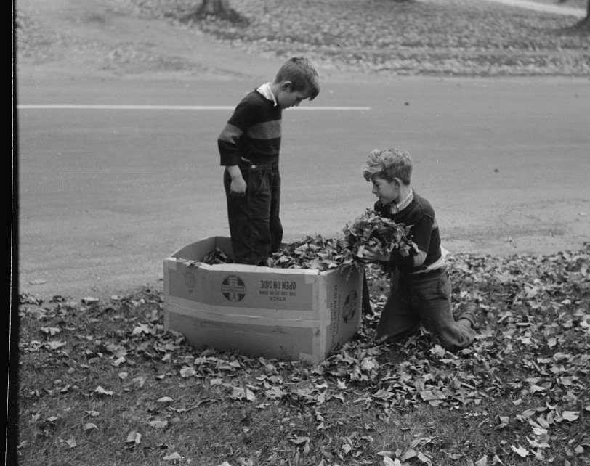

Think Inside the Box(es)
Excel-Hosted Dashboards With Python Graphics
Lightning Talks – Ted Conway

Slide 2
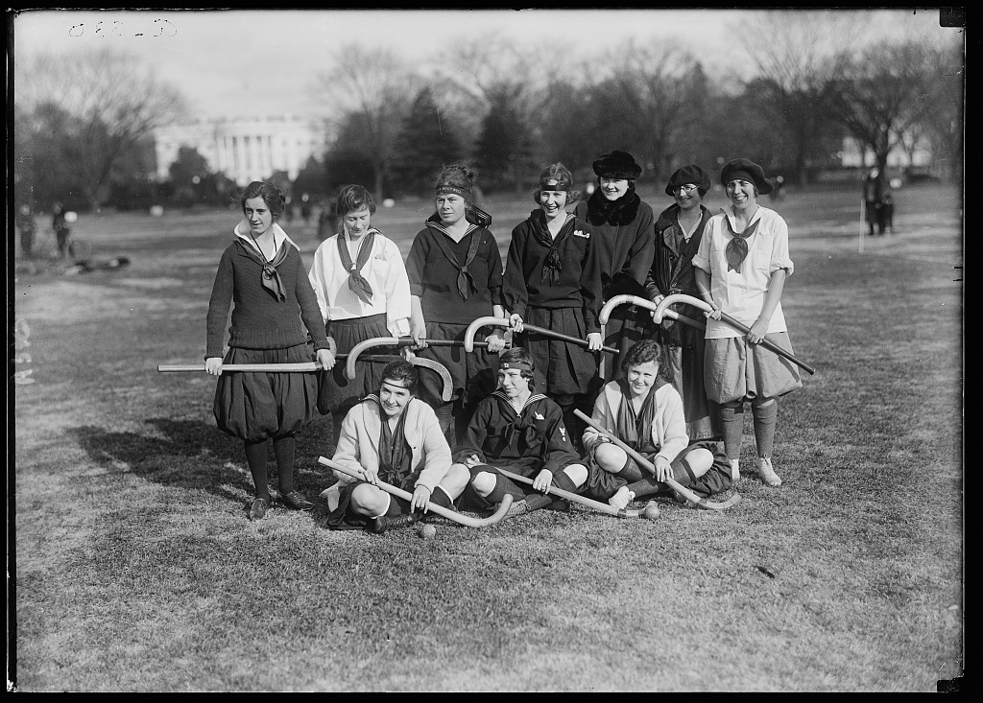
TODAY’S GAME PLAN
Notes:
https://www.loc.gov/item/hec2013000279/

Slide 3
Why Host Python Graphics in Excel Dashboards?
An Excel-Based Python Graphics Playground
A Step-by-Step Look at How Things Works
A Quick Excel Dashboard Tour, Including a New York Times Data Viz Knockoff
AGENDA

Slide 4
import matplotlib.pyplot as plt
fig, ax = plt.subplots()
fruits = ['apple', 'blueberry', 'cherry', 'orange']
counts = [40, 100, 30, 55]
bar_colors = ['tab:red', 'tab:blue', 'tab:red', 'tab:orange']
ax.bar(fruits, counts, color=bar_colors)
ax.set_ylabel('fruit supply')
ax.set_title('Fruit supply by kind and color')
plt.show()

Slide 5
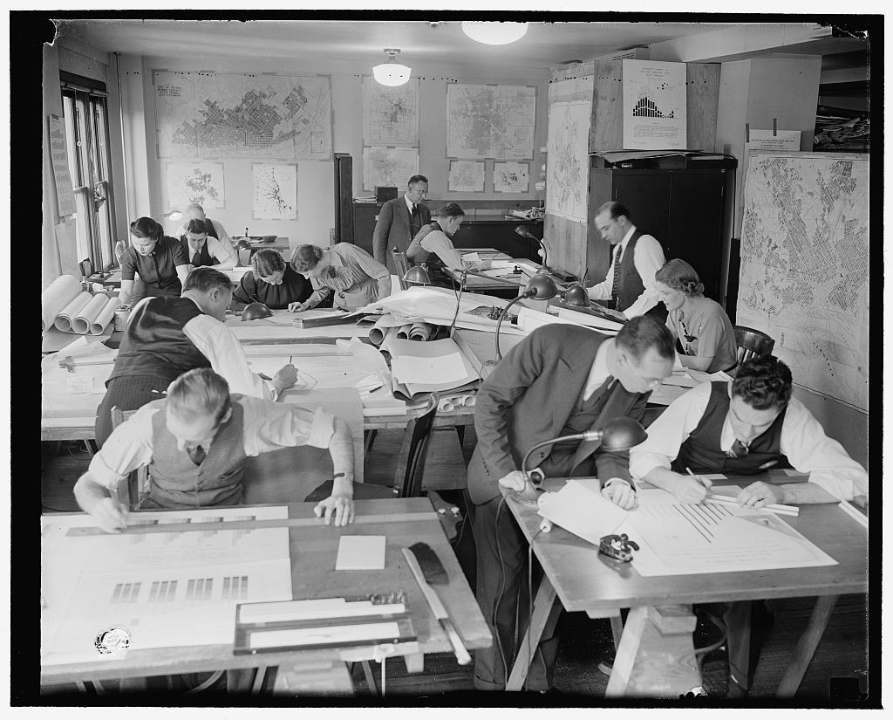
WHY EXCEL ?
Notes:
https://www.loc.gov/item/hec2009010889/

Slide 6
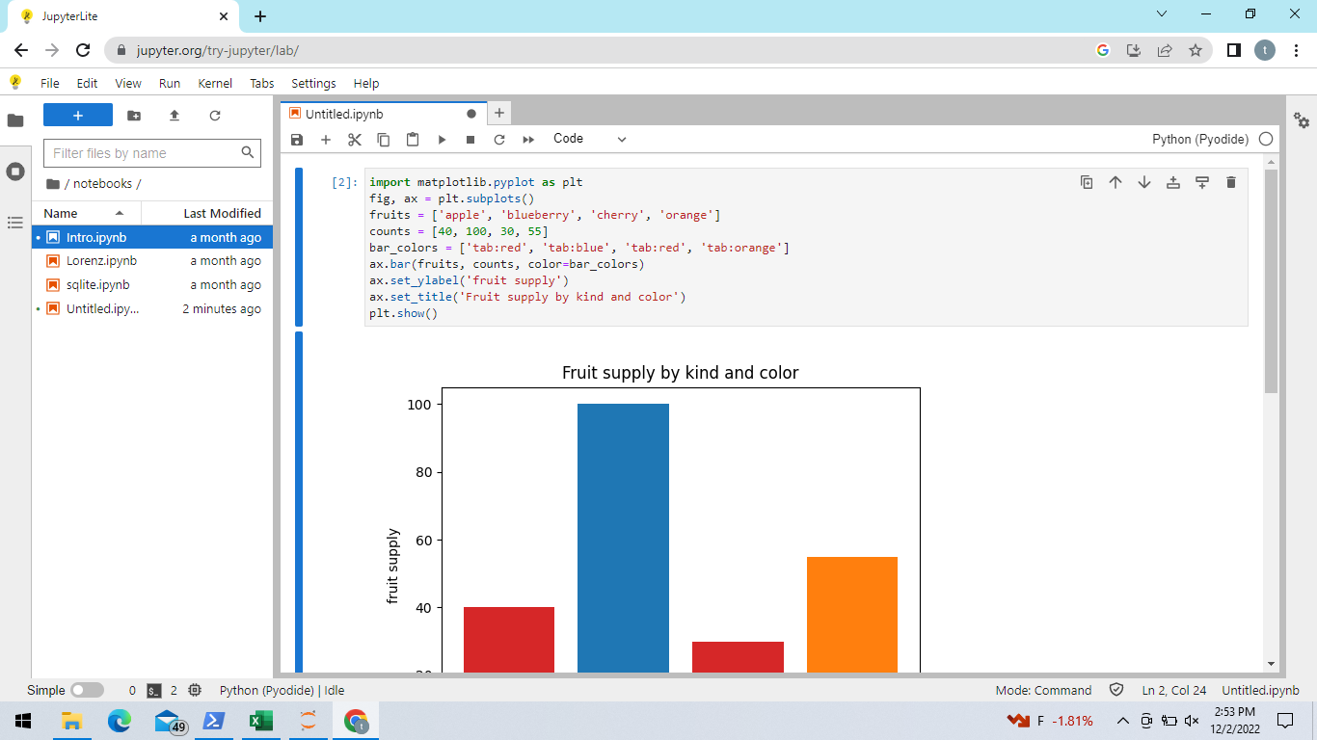
JUPYTER
HOSTED

Slide 7
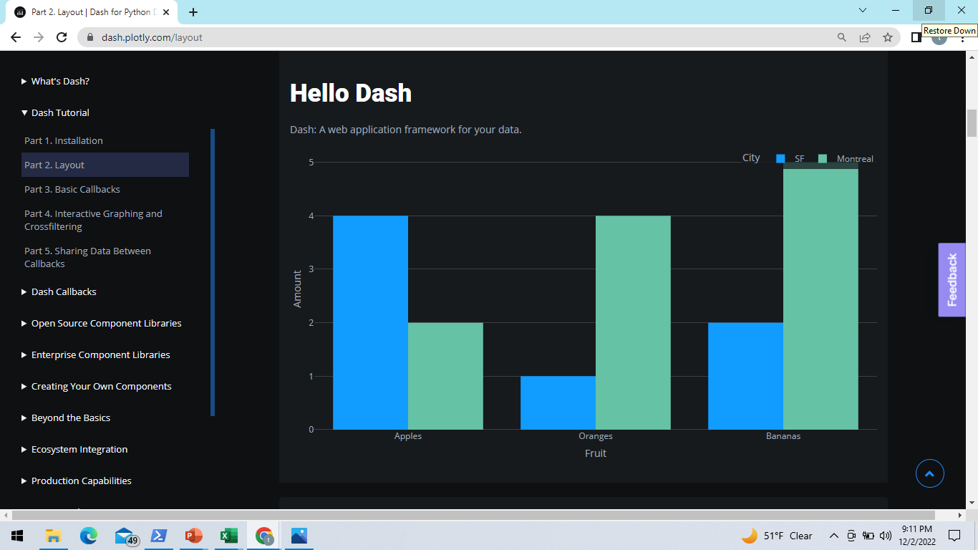
**
DASH/PLOTLY
HOSTED

Slide 8
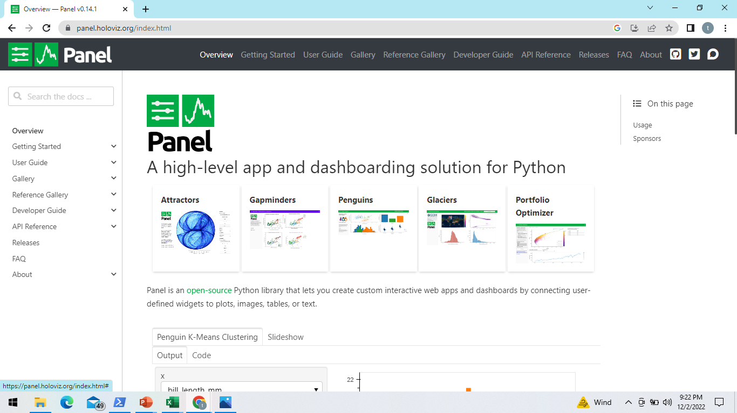
PANEL

Slide 9
UPSIDE
Ubiquitous, no install, simple, minimal training
Python-generated graphics images automatically sized and positioned to match containing cells and shapes, and inserted into Excel
Easily organize and share “live” Python code snippets in workbooks for learning or teaching
Can create Excel-based Python graphics dashboards
WHY EXCEL?
CAVEAT
Simplicity a feature and a bug – won’t replace other Open Source and commercial dataviz software

Slide 10
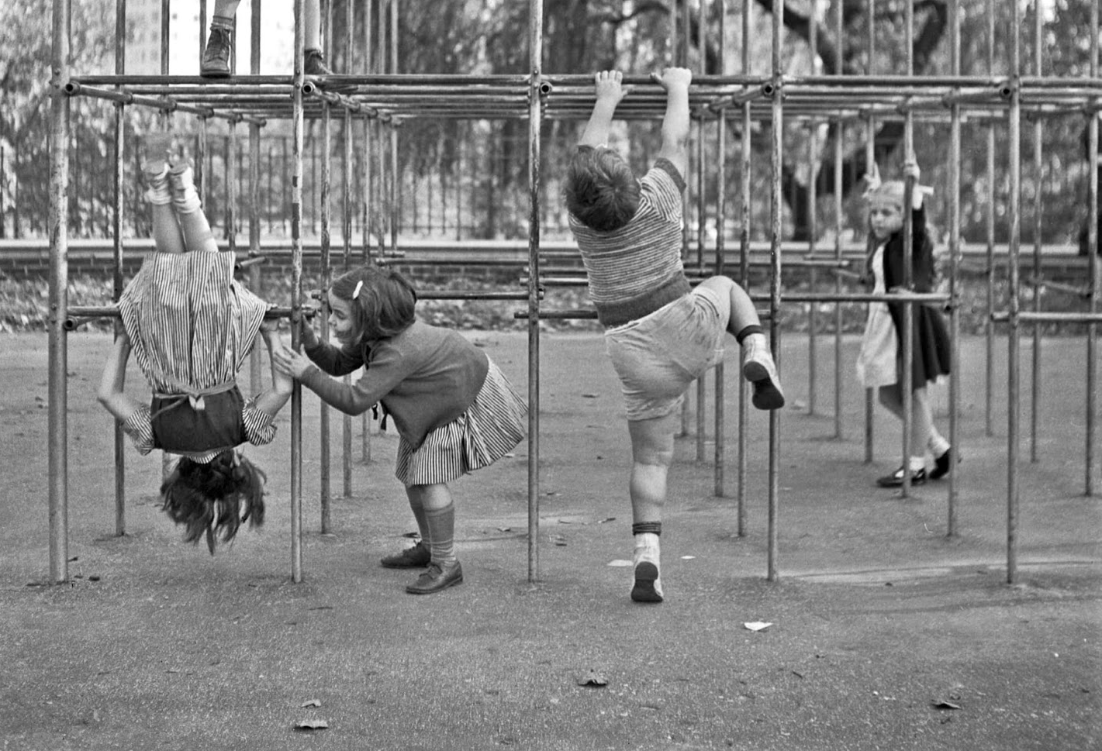
EXCEL “PLAYGROUND”
Notes:
https://www.loc.gov/item/owi2001012439/PP/

Slide 11
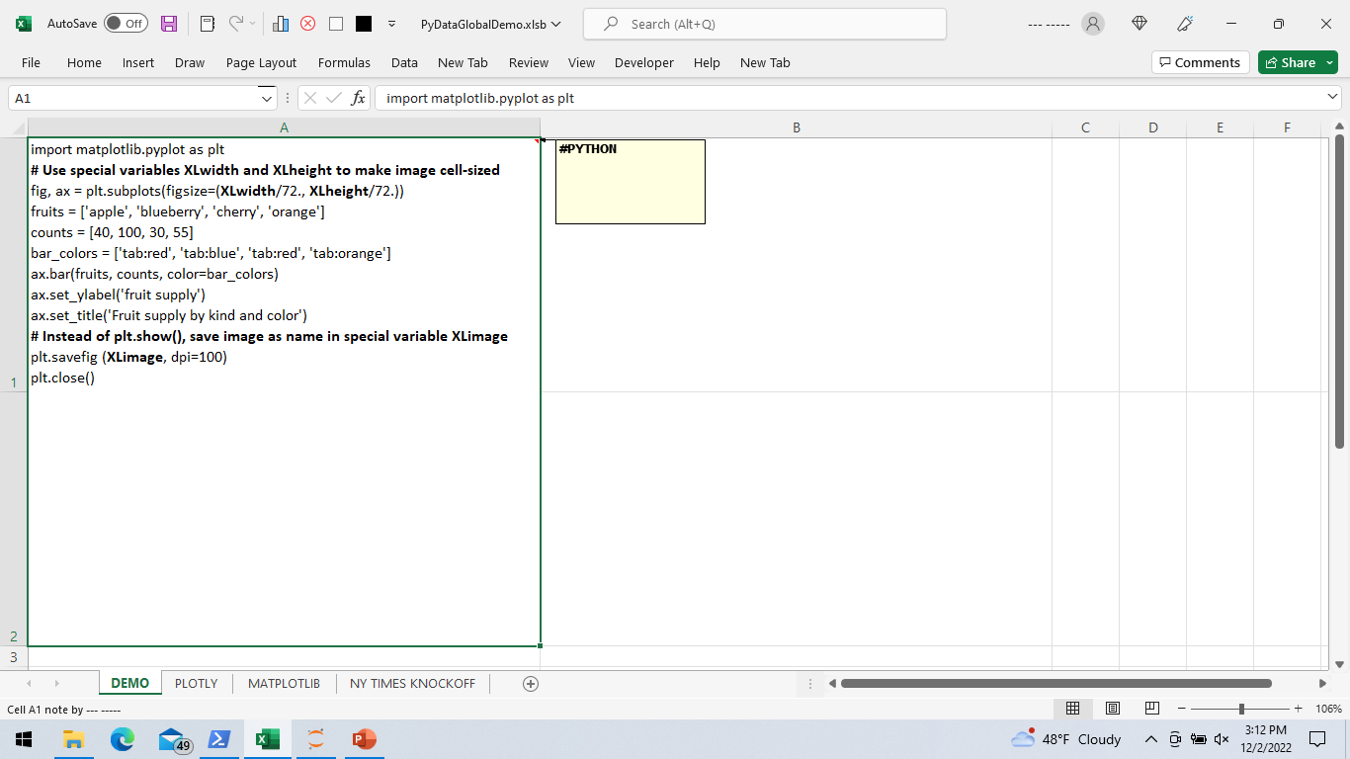
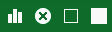
Toolbar Buttons
Draw Charts
 Delete Charts
 Show Charts
 Hide Charts
XLheight
XLwidth

Slide 12
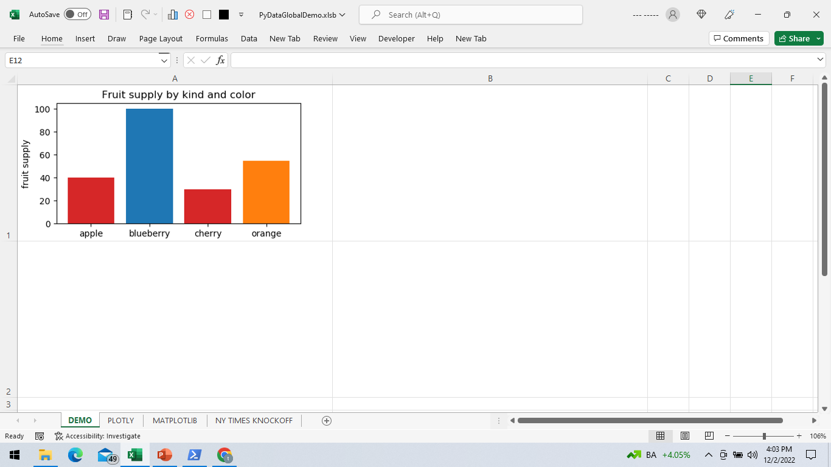

Slide 13
Python chart-generating code is placed in Excel cells tagged with comments starting with “#PYTHON”
Clicking a button causes VBA macro to write Python code to a file, including statements that create variables with cell dimensions (XLwidth, XLheight) and generated filenames (XLimage)
SendKeys is used to send an exec statement to Python, causing it to import code & create images
VBA macro waits for Python to complete (checks for “trigger” file) and then inserts images over cells that contained code
RECAP

Slide 14
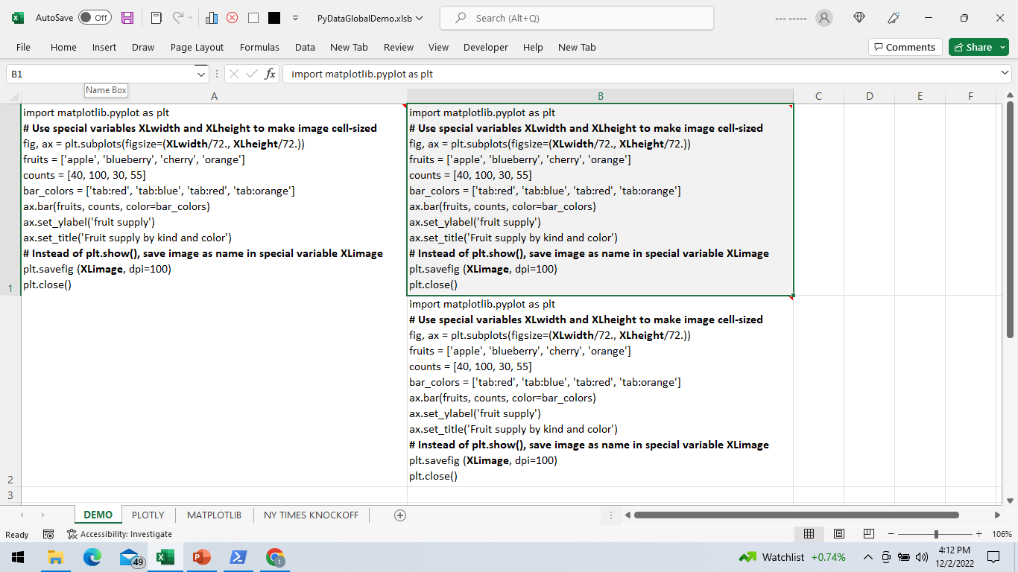
SAME CHART X 3
COPY CODE OR USE FORMULAS
CHARTS CAN SPAN CELLS

Slide 15
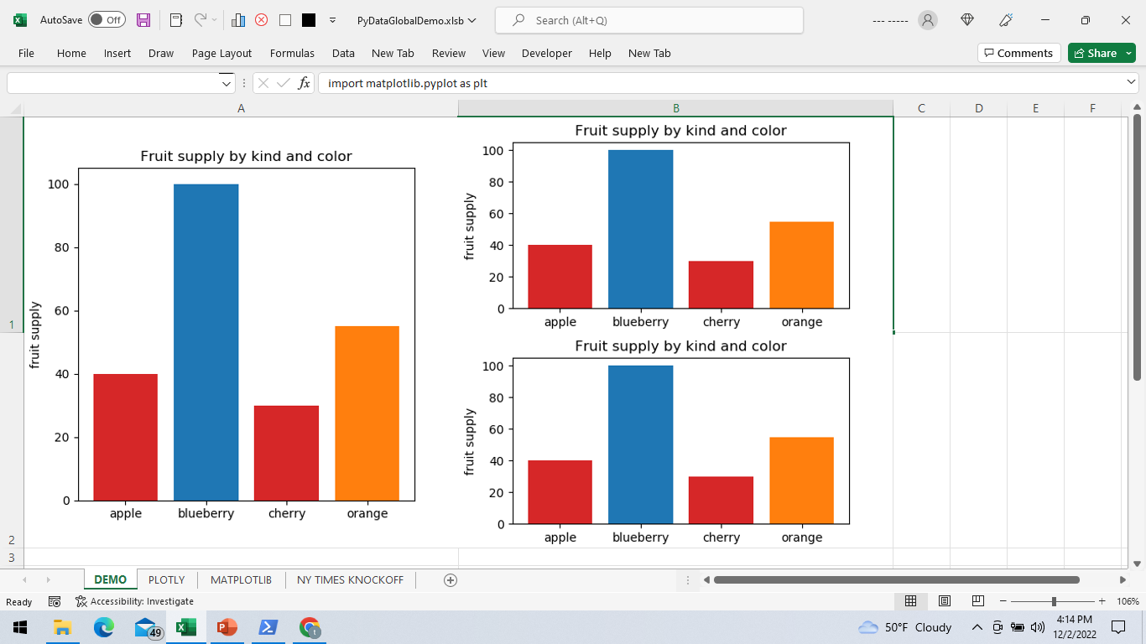

Slide 16
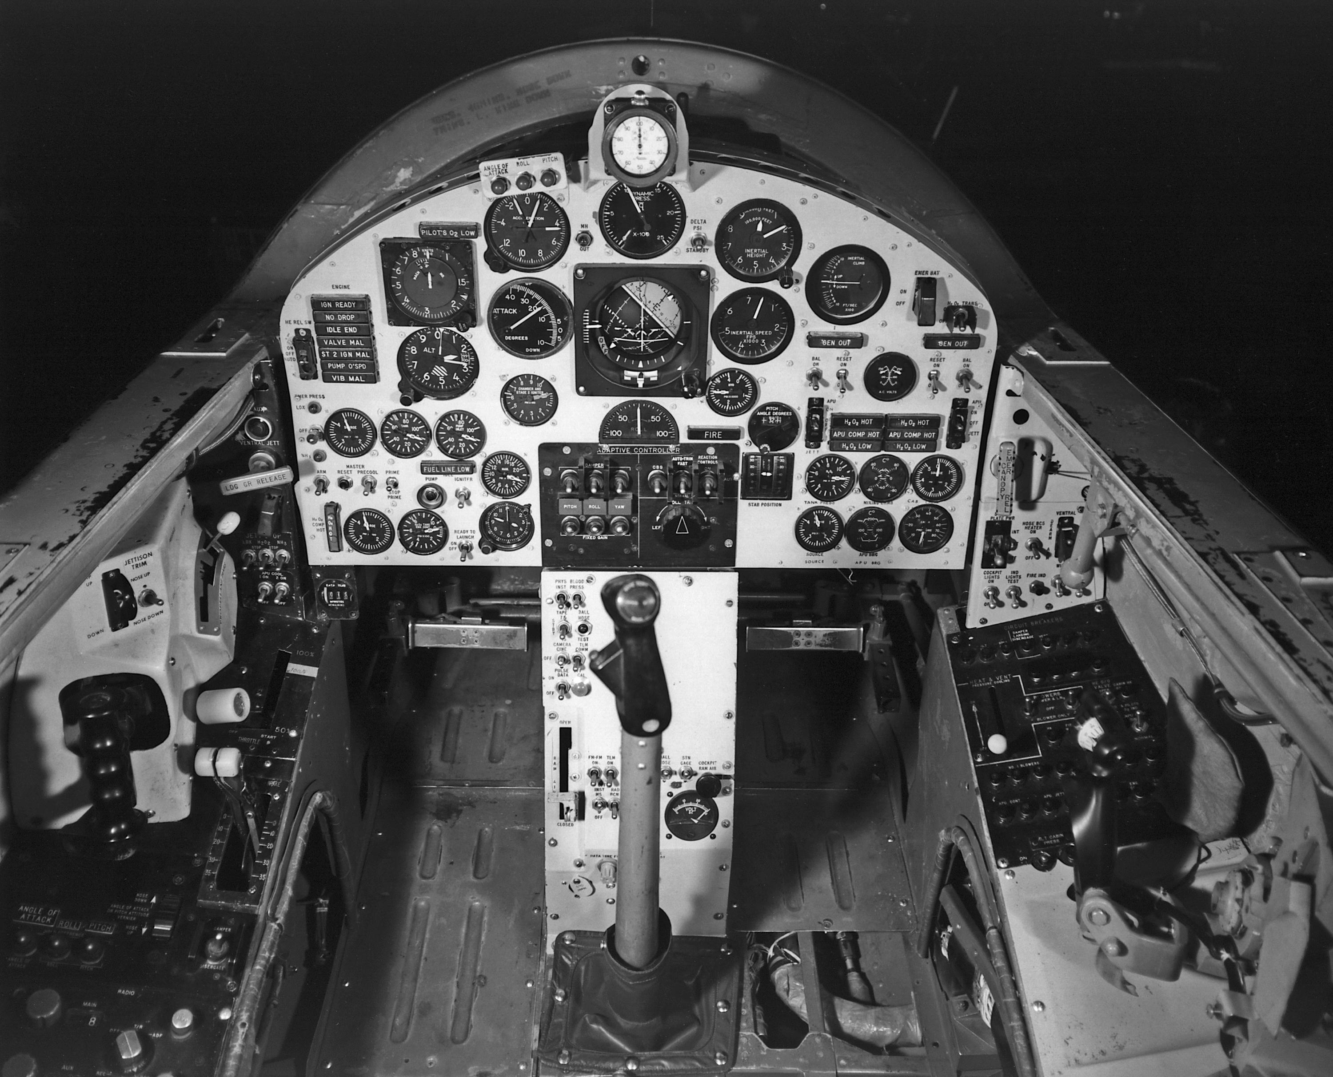
DASHBOARDS
Notes:
http://www.nasa.gov/centers/dryden/multimedia/imagegallery/X-15/E63-9834.html

Slide 17
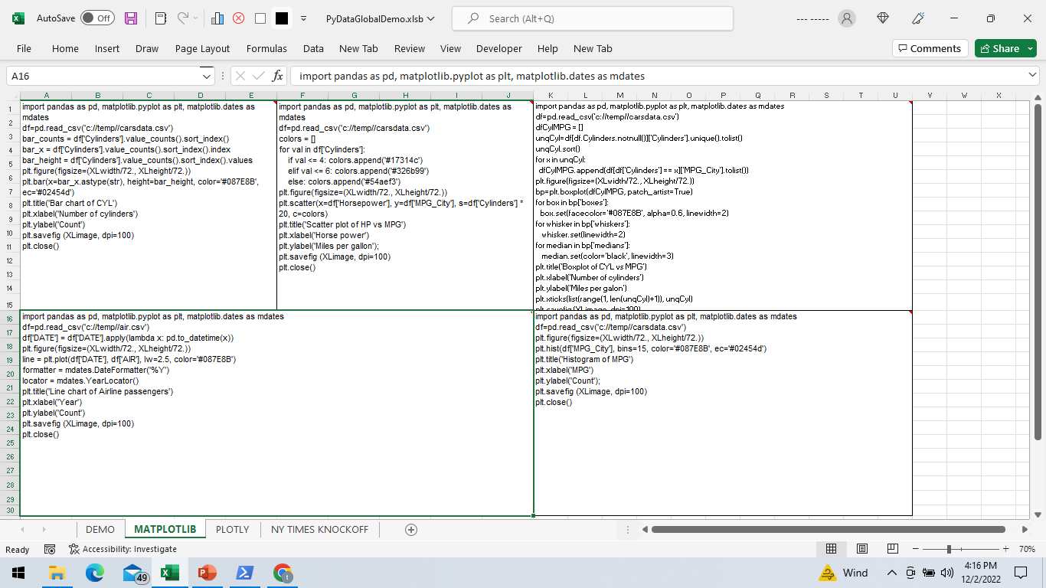
MATPLOTLIB
EXAMPLE

Slide 18
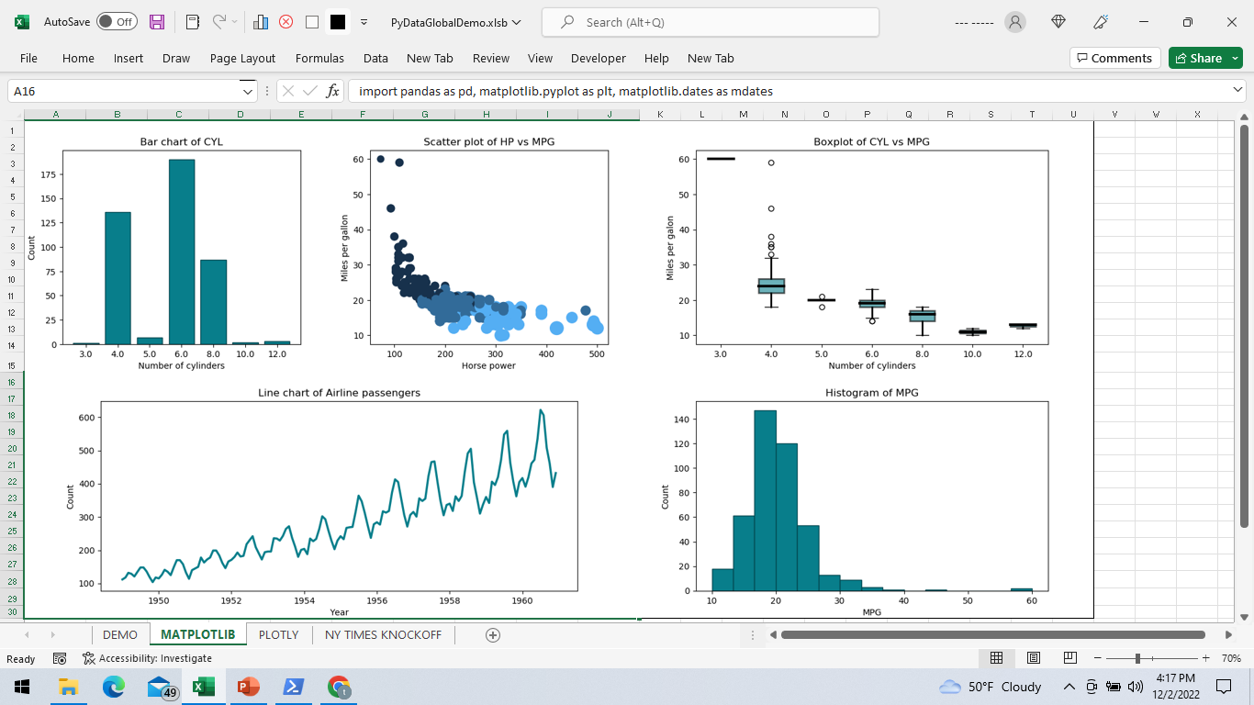

Slide 19
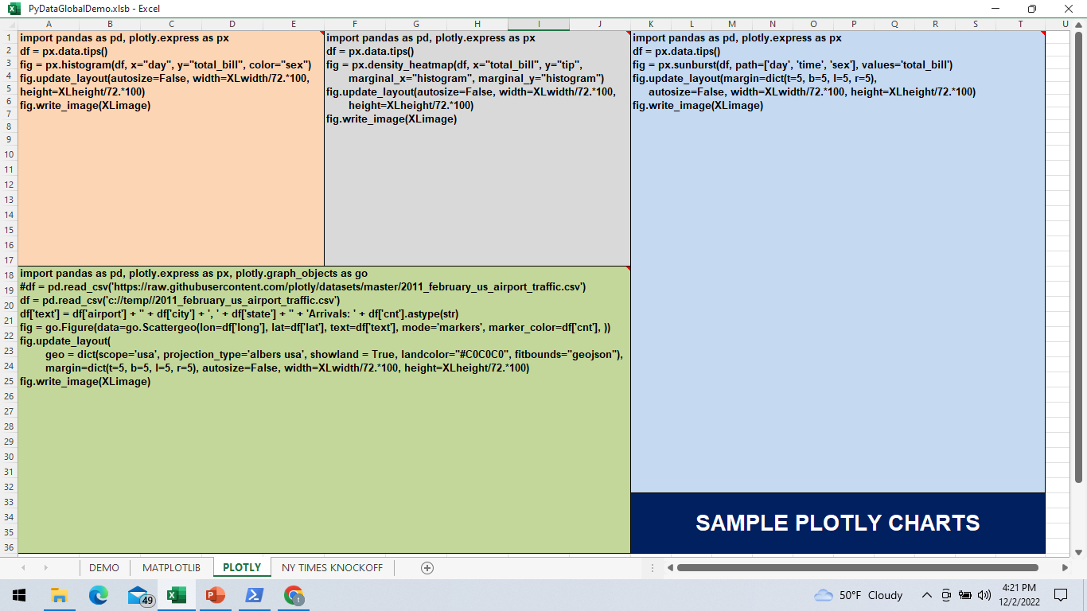

Slide 20
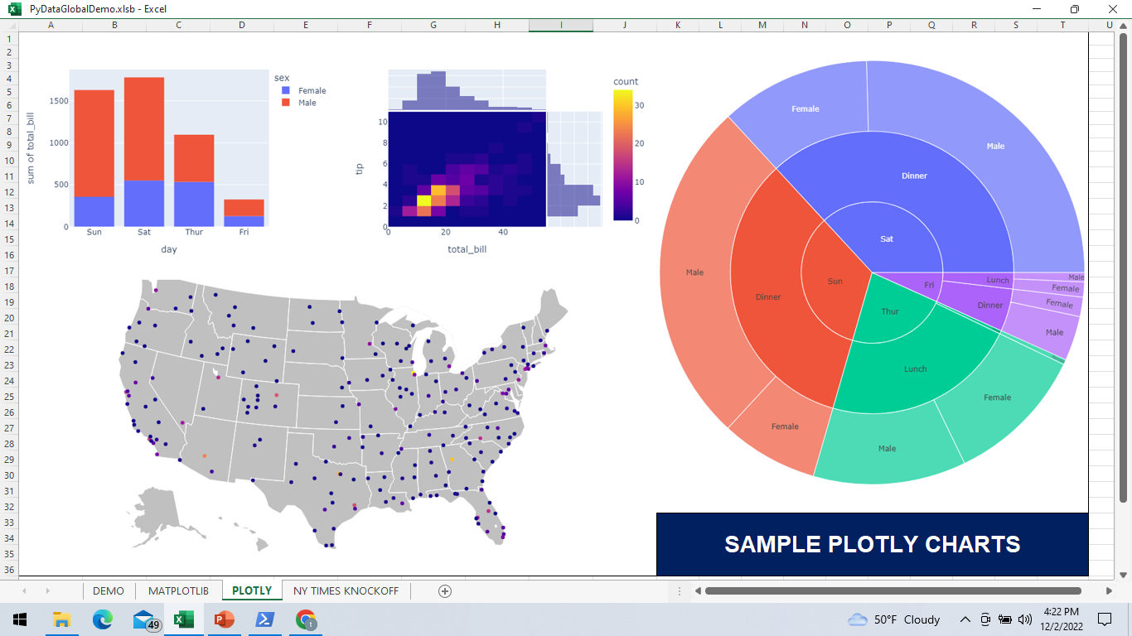

Slide 21
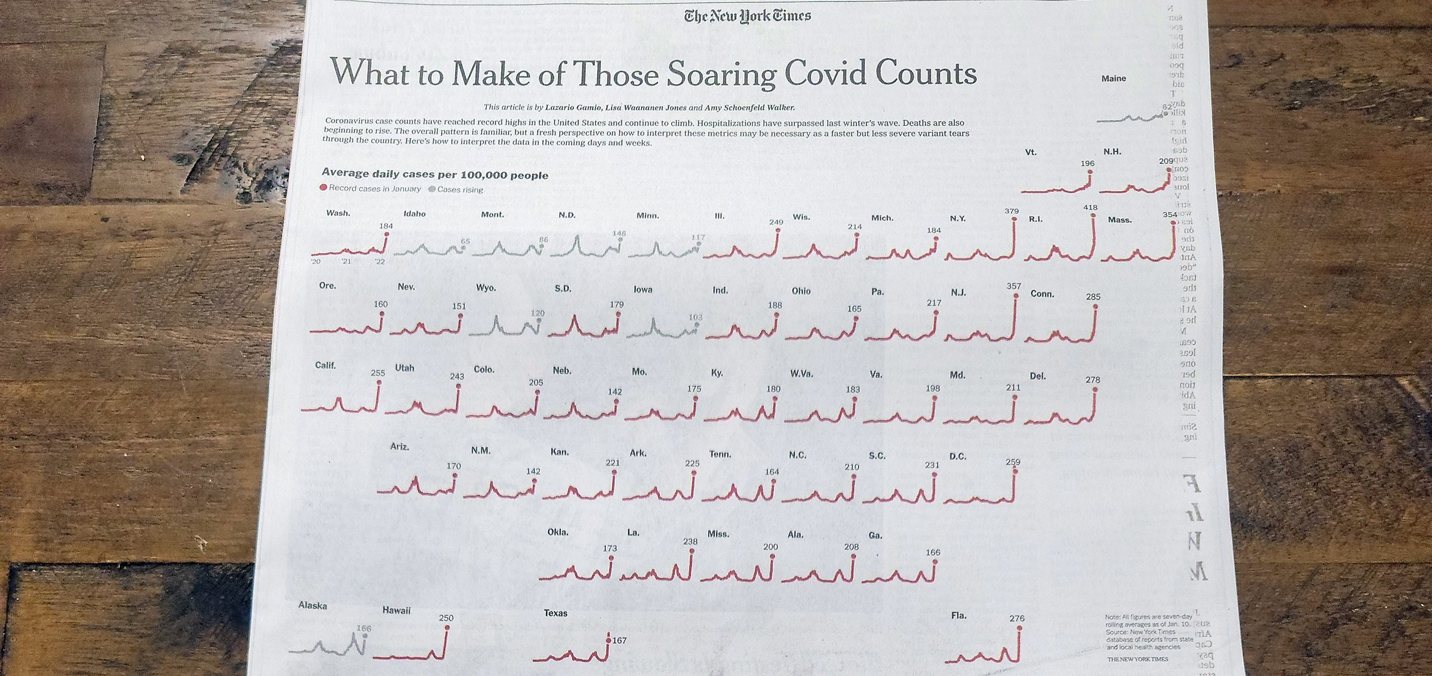

Slide 22
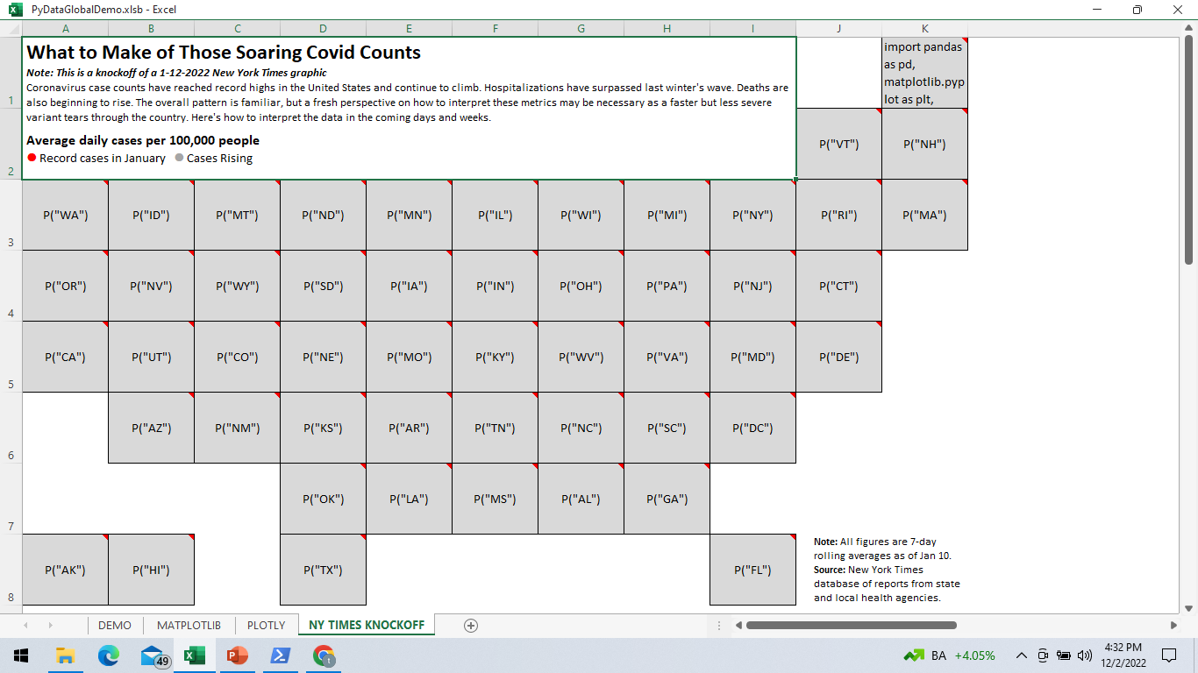
NYT KNOCKOFF
“MAIN” CODE IS IN MAINE
OTHER STATES CALL FUNCTION
USE OTHER CELLS FOR NARRATIVE

Slide 23
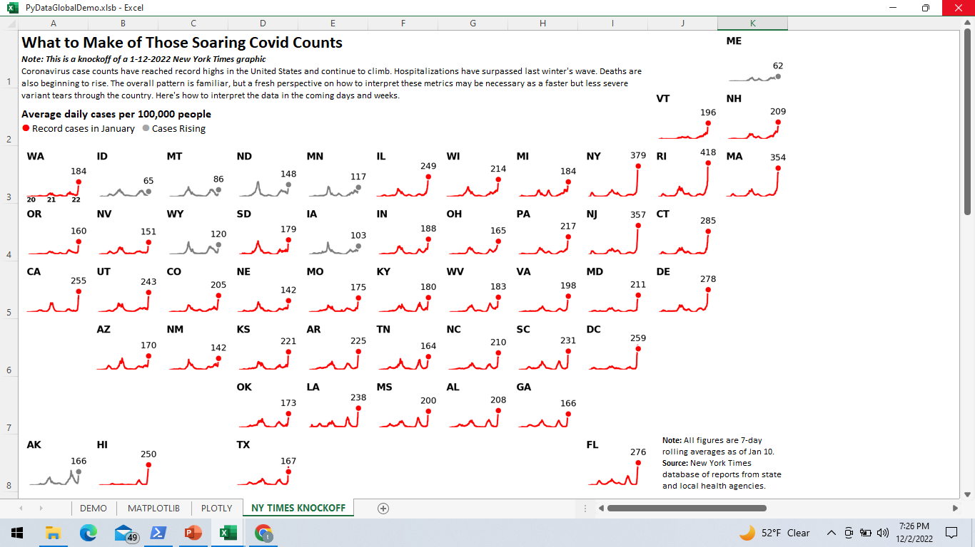

Slide 24
import pandas as pd, matplotlib.pyplot as plt, matplotlib.dates as mdates # Replicate 1-12-2-20222 NYT Covid Case Map
dfall=pd.read_csv('c://temp//nyt.csv') # Get NYT data
def P(stcode): # Function P plots chart for each state
df=dfall[dfall["st"]==stcode] # Get daily case data for state
df['date'] = df['date'].apply(lambda x: pd.to_datetime(x)) # Convert dates to datetimes
plt.figure(figsize=(XLwidth/72., XLheight/72.)) # Make chart same size as Excel cell
plt.axis('off') # Turn off axis
ax = plt.gca() # Fix axes limits for all charts
ax.set_xlim([datetime.date(2020, 1, 21), datetime.date(2022, 2, 10)]) # 2020-1-21 to 2022-2-10 report dates
ax.set_ylim(ymin=0, ymax=550) # 0 to 550 incidents
# State code in upper left corner
plt.text(0, 1, df["st"].iloc[-1], ha='left', va='top', transform=ax.transAxes, color='black', fontsize=10, weight="bold")
# Ending number of cases over last point
plt.text(x=df['date'].iloc[-1], y=df['cases_avg_per_100k'].iloc[-1]+75, s=df['EndingCasesX'].iloc[-1].astype(int).astype(str), color='black', fontsize=9, ha='center', va='bottom')
# Line plot of cases/100K of population, red/gray colors denote case trend
line = plt.plot(df['date'], df['cases_avg_per_100k'], lw=1.5, color=df['trend'].iloc[-1])
# Marker surrounded by whitespace for ending # of cases
plt.scatter(x=df['date'].iloc[-1], y=df['cases_avg_per_100k'].iloc[-1], s=44, facecolors=df['trend'].iloc[-1], edgecolors='white', zorder=10)
if df["st"].iloc[-1]=="WA": # Years of data eyecatcher for Washington State chart - 20/21/22
plt.text(0, 0, "20", ha='left', va='top', transform=ax.transAxes, fontsize=7, weight="bold")
plt.text(x=pd.to_datetime('2021-01-01'), y=1, s='21', ha='center', va='top', fontsize=7, weight="bold")
plt.text(1, 0, "22", ha='right', va='top', transform=ax.transAxes, fontsize=7, weight="bold")
plt.savefig (XLimage, dpi=200) # Save figure to unique filename
plt.close() # Close file
P("ME") # Invoke plotting function for Maine
CODE

Slide 25
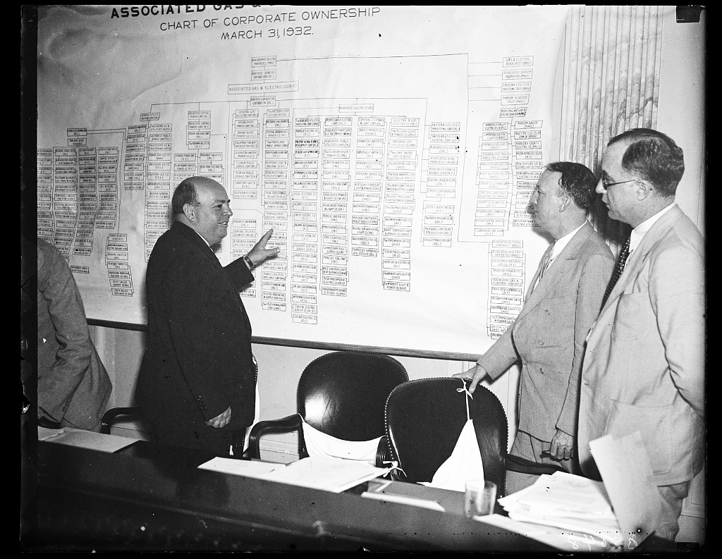
HOW IT WORKS
Notes:
https://www.loc.gov/item/hec2013009219/

Slide 26
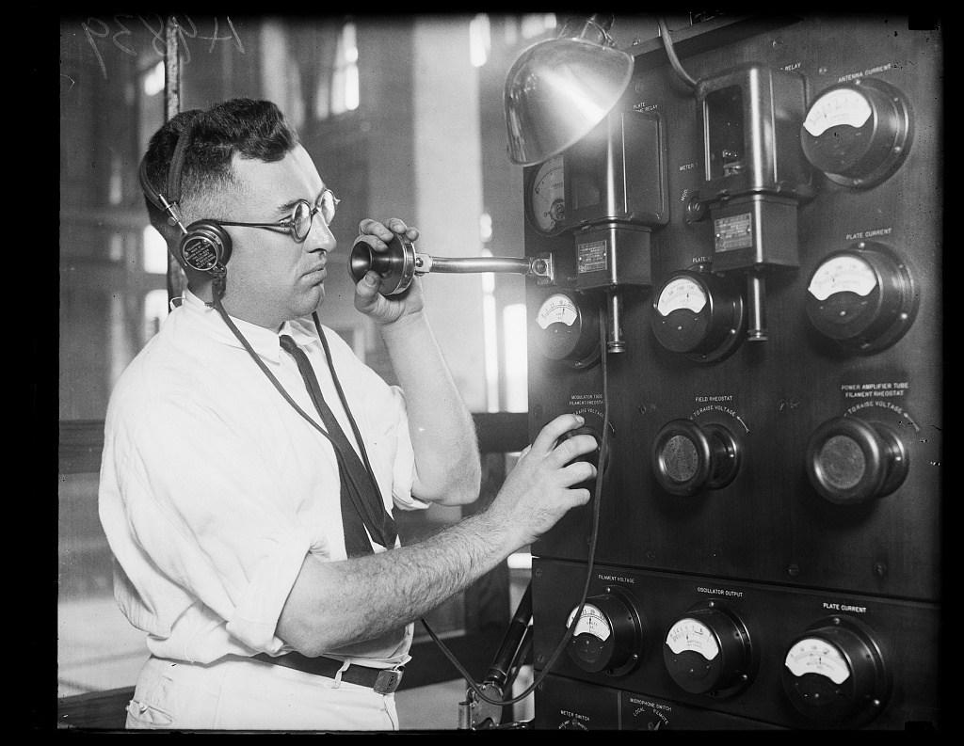
COMMUNICATION

Slide 27
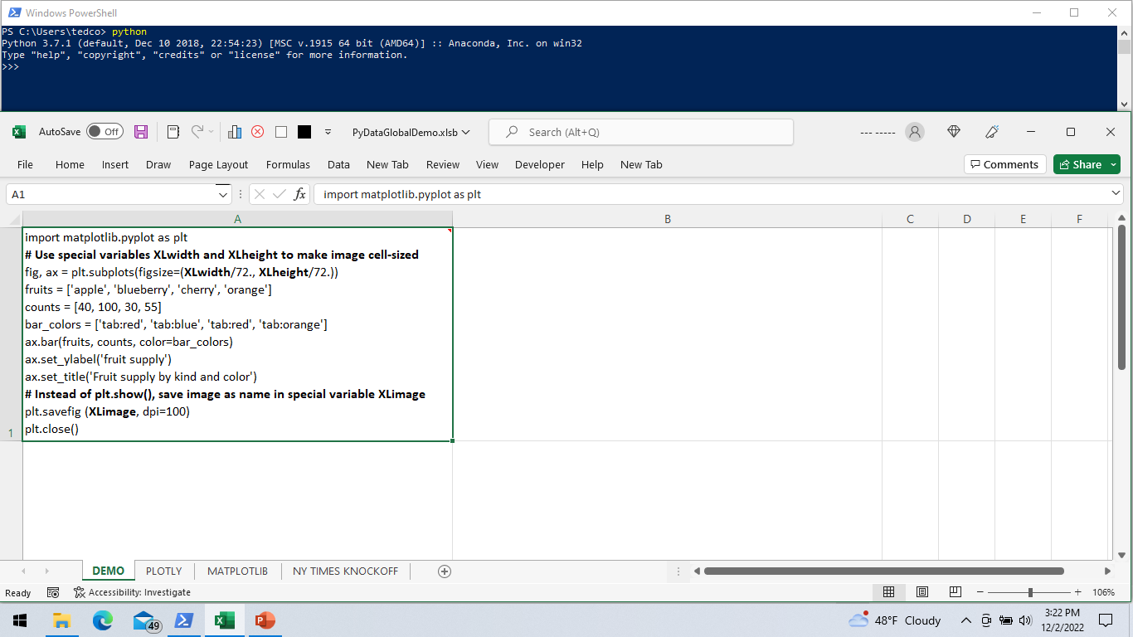

Slide 28
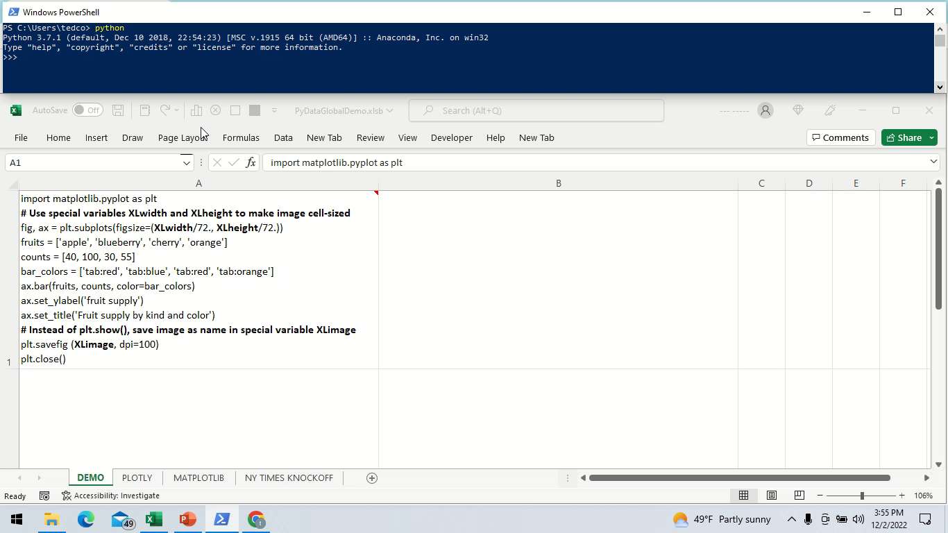
A RECORDED DEMO

Slide 29
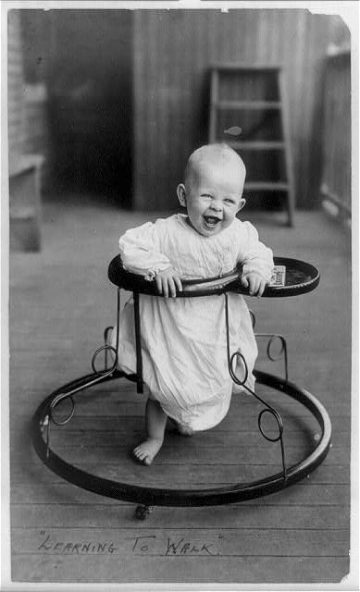
STEP-BY-STEP
Notes:
https://www.loc.gov/item/96509301/

Slide 30




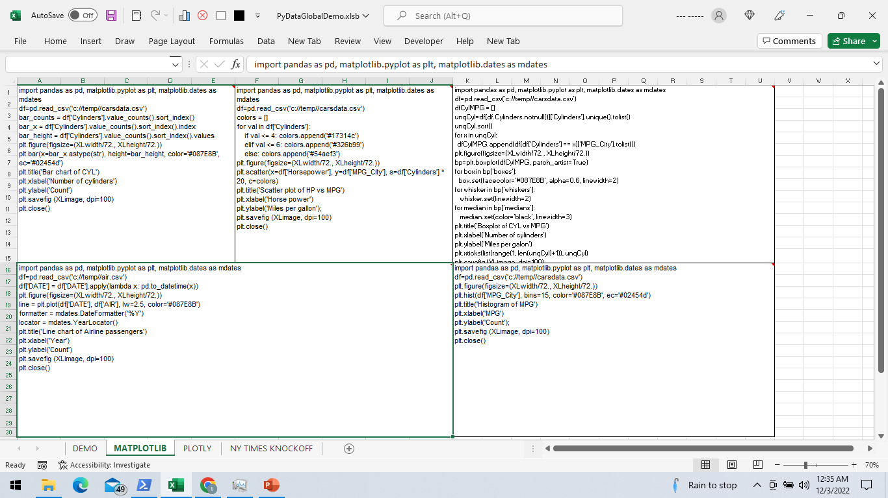
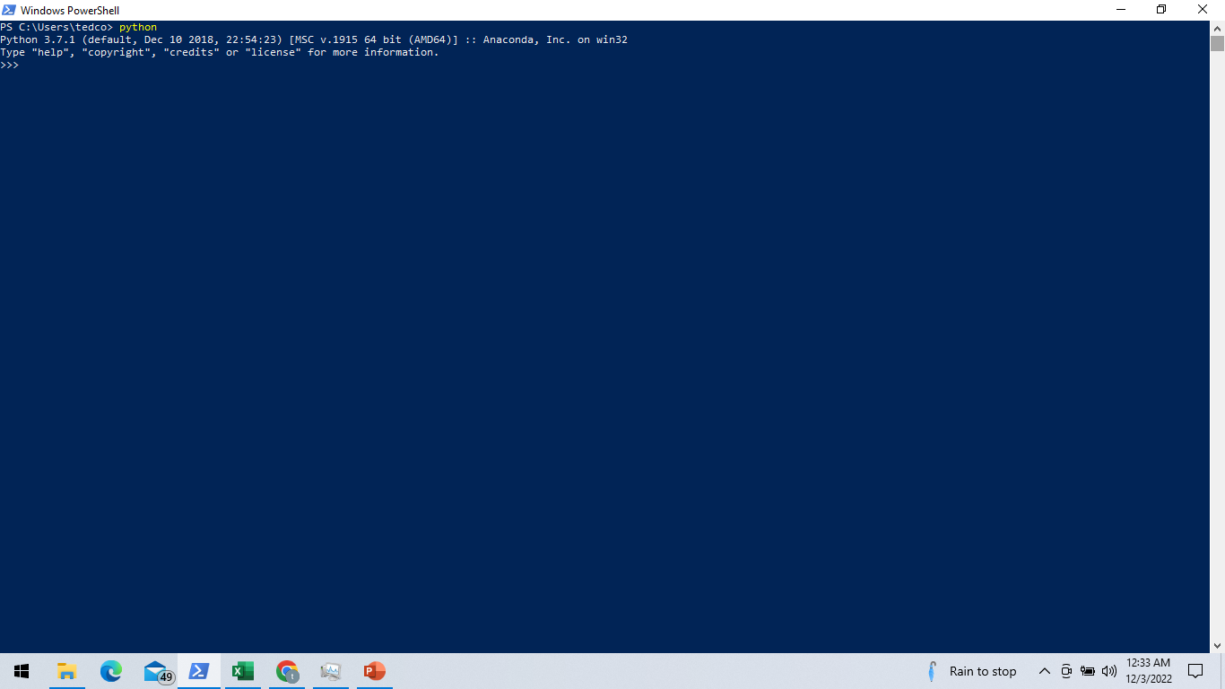
Python chart-generating code is entered into image-sized Excel cells

Slide 31
Excel toolbar button is pressed to run chart generation macro

Slide 32

CodeToRun.py
Excel macro writes Python code to file (incl. code to set image sizes)

Slide 33

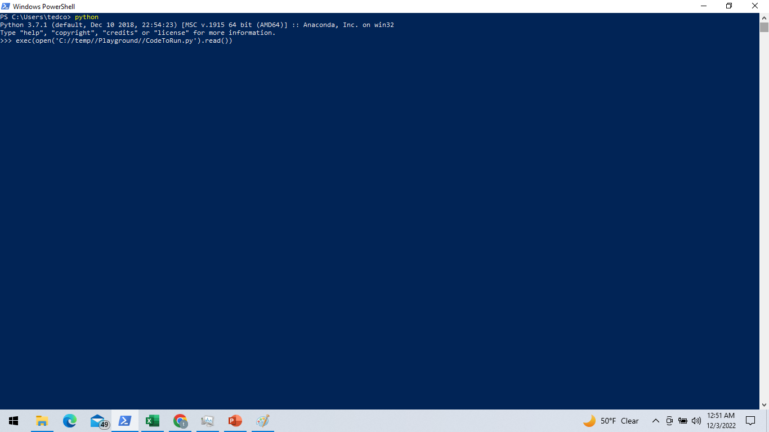
exec(open('C://temp//Playground//CodeToRun.py').read())
Excel macro sends keystrokes to Python with statements to run code

Slide 34



?
CodeToRunDone.txt
Python script starts & Excel waits for trigger file indicating complete

Slide 35

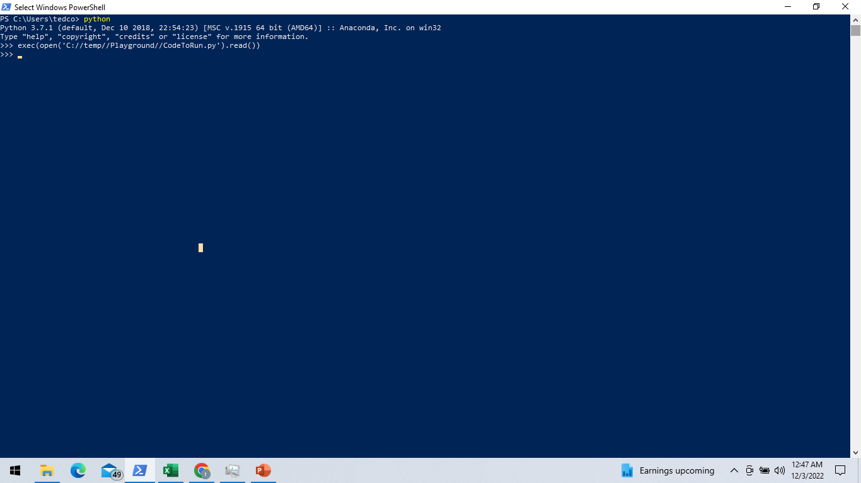
✓
Python code runs, producing output chart images and trigger file

Slide 36

Pychart1-N.png
Excel resumes, retrieves images & places them into cells over code

Slide 37
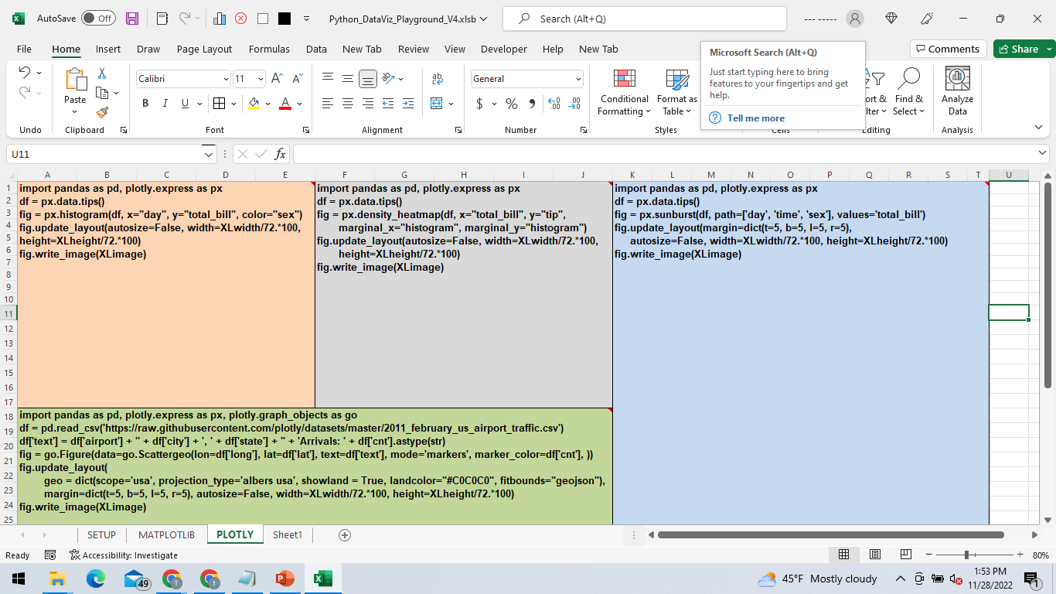
Excel macro writes Python code to file (incl. code to set image sizes)

Slide 38
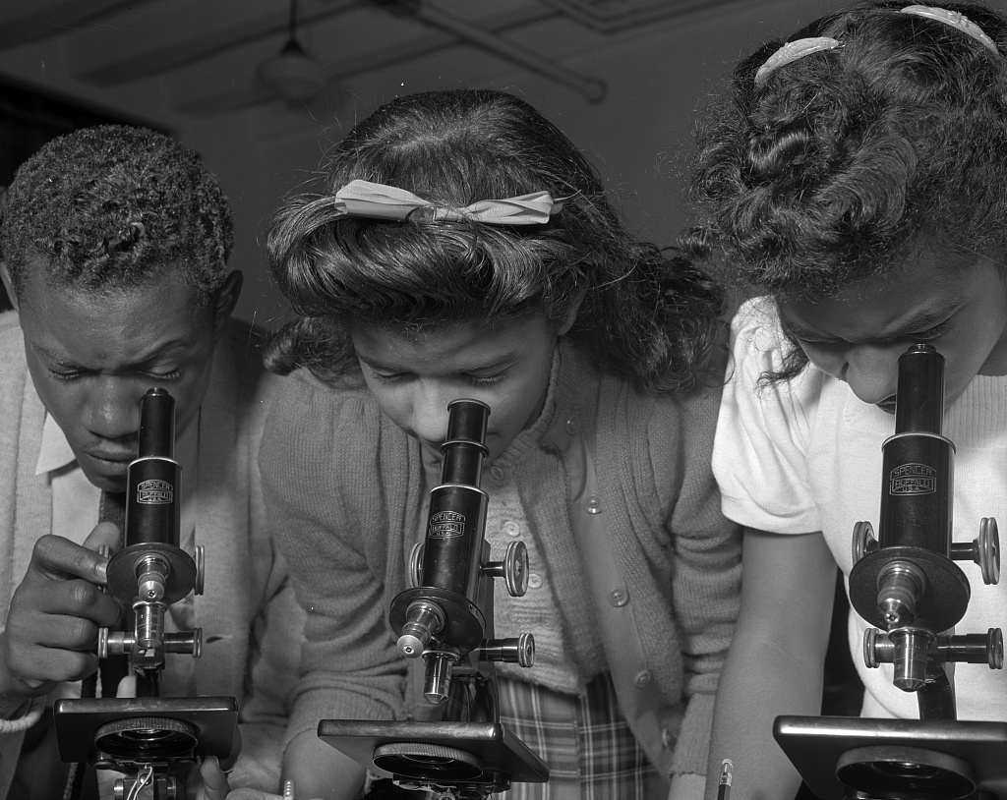
A LOOK AT THE CODE
Notes:
https://www.loc.gov/resource/fsa.8d13834/

Slide 39
'==> Use Windows 32 or 64-bit routines to sleep for # of milliseconds
#If VBA7 Then
Public Declare PtrSafe Sub Sleep Lib "kernel32" (ByVal dwMilliseconds As LongPtr) ' Sleep funcion (msec) for 64 bit systems
#Else
Public Declare Sub Sleep Lib "kernel32" (ByVal dwMilliseconds As Long) ' Sleep funcion (msec) for 32 bit systems
#End If
'==> Create Excel charts by calling Python with cell width/height & code from each tagged comment/cell
Public Sub DrawCharts()
DeleteCharts ' Get rid of any existing charts
pcdir = Sheets("Setup").Range("A2") ' Get PC and VMware/Oracle VM Box folder names from setup tab (same physically)
vmdir = Sheets("Setup").Range("A4")
Open pcdir & "CodeToRun.py" For Output As #1 ' Create Python program
i = 0 ' Image counter
For Each cmt In ActiveSheet.Comments ' Get Python code from comment and/or cell
If UCase(Left(cmt.Text, 7)) = "#PYTHON" Then ' Python code tagged cell?
i = i + 1 ' Initialize Python ODS Graphics settings (height/width/PATH/DPI)
Print #1, "XLwidth=" & cmt.Parent.MergeArea.Width & Constants.vbCrLf & _
"XLheight=" & cmt.Parent.MergeArea.Height & Constants.vbCrLf & _
"XLimage='" & vmdir & "Pythonchart" & i & "." & Sheets("Setup").Range("A9") & "'" & Constants.vbCrLf & _
Replace(cmt.Parent.Value, Chr(10), vbCrLf) & Constants.vbCrLf & cmt.Text
Debug.Print cmt.Parent.Value
On Error Resume Next ' Delete existing image, if any
Kill pcdir & "Pythonchart" & i & "." & Sheets("Setup").Range("A9")
On Error GoTo 0
End If
Next cmt
imagesexpected = i ' Save number of images expected
Print #1, "XLf=open('" & vmdir & "CodeToRunDone.txt','w')" & Constants.vbCrLf & _
"XLf.write('Done')" & Constants.vbCrLf & _
"XLf.close()"
Close #1
On Error Resume Next ' Delete existing trigger file (used to indicate Python is done)
Kill pcdir & "CodeToRunDone.txt"
On Error GoTo 0 ' Activate Python and run code
Sleep (1000) ' Sleep for 1 second
AppActivate Sheets("Setup").Range("A15"), True ' Activate Python and submit code via SendKeys function
Sleep (1000) ' Sleep for 1 second
SendKeys "exec{(}open{(}'" & vmdir & "CodeToRun.py'{)}.read{(}{)}{)}{ENTER}", True;
i = 0 ' Wait for Python code to finish
While (Dir$(pcdir & "CodeToRunDone.txt") = "")
Sleep (1000) ' Sleep for 1 second
i = i + 1
If i > Sheets("Setup").Range("A13") Then ' Timeout after specified # of seconds
w = MsgBox("Still unfinished, wait?", vbYesNo) ' After specified # of seconds, ask if user wants to continue or bail
If w = vbNo Then Exit Sub
i = 0
End If
Wend
EXCEL VBA - 1

Slide 40
i = 0
For Each cmt In ActiveSheet.Comments ' Retrieve and position Python-generated images
If UCase(Left(cmt.Text, 7)) = "#PYTHON" Then ' Python code tagged cell?
i = i + 1 ' If error, Python may not create image
If Dir$(pcdir & "Pythonchart" & i & "." & Sheets("Setup").Range("A9")) <> "" Then
Set newshape = ActiveSheet.Shapes.AddPicture(pcdir & "Pythonchart" & i & "." & Sheets("Setup").Range("A9"), False, True, _
cmt.Parent.Left, cmt.Parent.Top, cmt.Parent.MergeArea.Width, cmt.Parent.MergeArea.Height)
newshape.AlternativeText = "*Python;"
imagesinserted = imagesinserted + 1 ' Count images inserted
End If
End If
Next cmt
wbname = Split(ActiveWorkbook.Name, ".")
AppActivate wbname(LBound(wbname)) ' "Excel"
' Make sure we got expected # of images, issue error if not
If imagesexpected <> imagesinserted And Left(UCase(Sheets("Setup").Range("A17")), 1) = "Y" Then
i = MsgBox("CHECK Python LOG: ONLY " & imagesinserted & " OF " & imagesexpected & " IMAGES INSERTED", vbOKOnly, "CODE PLAYGROUND ALERT")
End If
End Sub
'==> Delete any existing Python-generated charts
Sub DeleteCharts()
C = ActiveSheet.Shapes.Count
For i = C To 1 Step -1
If ActiveSheet.Shapes(i).AlternativeText = "*Python;" Then ActiveSheet.Shapes(i).Delete
Next
End Sub
'==> Hide any existing Python-generated charts
Sub HideCharts()
C = ActiveSheet.Shapes.Count
For i = C To 1 Step -1
If ActiveSheet.Shapes(i).AlternativeText = "*Python;" Then ActiveSheet.Shapes(i).Visible = False
Next
End Sub
'==> Show any existing Python-generated charts
Sub ShowCharts()
C = ActiveSheet.Shapes.Count
For i = C To 1 Step -1
If ActiveSheet.Shapes(i).AlternativeText = "*Python;" Then ActiveSheet.Shapes(i).Visible = True
Next
End Sub
EXCEL VBA - 2

Slide 41
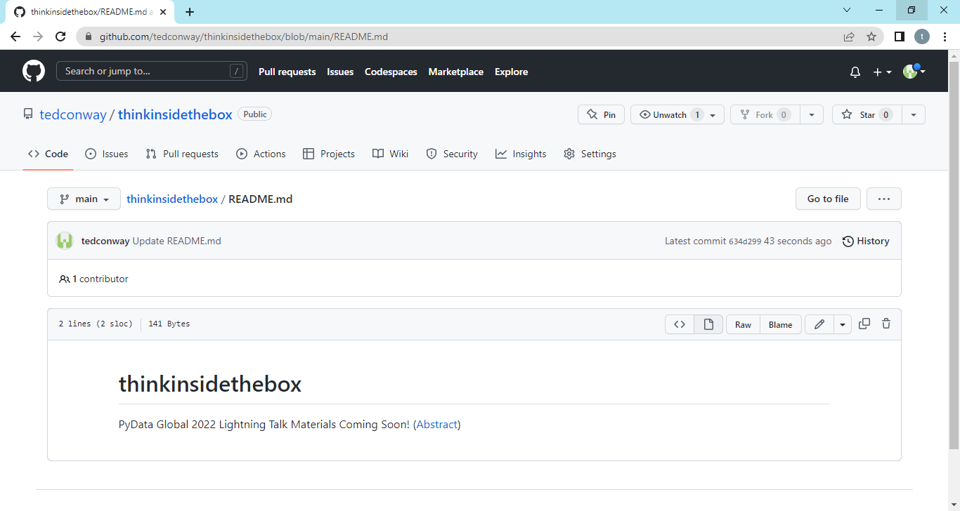
COMING SOON!

Slide 42
“All models are wrong, but some are useful.”
– George Box
“All VBA tricks are stupid, but some are useful.”
– Ted Conway

Slide 43
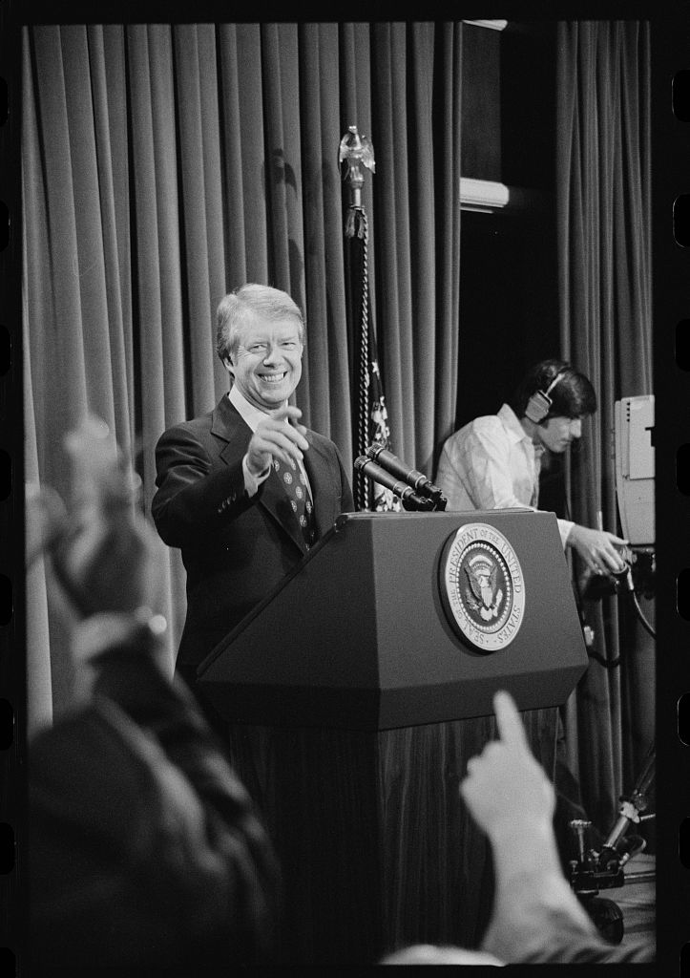
QUESTIONS ?
Notes:
https://www.loc.gov/item/2005696421/ Harris & Ewing, photographer, 1925, https://www.loc.gov/rr/print/res/140_harr.html

Slide 44
Thank you!
Ted Conway ted.j.conway@gmail.com
@vivasasvegas

